Slide 1

Implementation of business information system in a company
Georgi, Gabi, Eli

Slide 2
Description of the company
Hostakis
Hostakis is a Data Center Service & Server Hosting Provider with privately-owned Infrastructure in Cyprus, Malta, United Kingdom, Netherlands, Singapore, Los Angeles and Hong Kong.
The company has 14 employees: CEO, CTO, CFO; Back office: 2; Web Dev: 2; Sales: 2, Customer care: 2; Tech Team: 3
Hostakis provides high-speed connectivity, ultra low latency hosting and cloud scalability.
Notes:
Габи

Slide 3
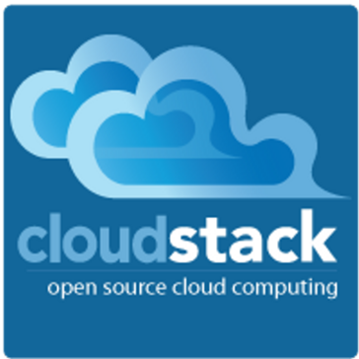
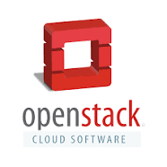

Hostakis
The main operational processes in the company are:
Taking customer orders(sales department)
Service provisioning(tech department) - process to deliver a service to the customers, once they have placed an order.
At the moment the company manages this process manually. To automatize and make provisioning more effective, OpenStack can be deployed to control the servers across datacenters.
Alternatives: CloudStack
Example case:
A customer orders a bare metal server with specific parameters, receives an invoice from the sales team, and after payment tech team does the following steps:
Checks the inventory for a free server with the given parameters and/or parts available to build it.
If there is no server available in stock, an order is made to a supplier.
The server is provisioned to the customer with the desired operating system. IP and administrator/root login credentials are provided securely.
Notes:
Габи

Slide 4
The main supporting processes in the company are:
Accounting- the accountant gathers information about the business transactions and then records and collates them to come up with values to be reported. The financial information is presented in reports(financial statements).
Billing Process- simplifies the process of data collection by creating an automatic record of all bills.
Back-office operations are involved with the change of accounts and subscriptions. They take care of settlements, clearances, record maintenance, and regulatory compliance. For example, a salesperson may enlist the help of back-office staff to provide accurate information on the inventory of servers or the pricing of a service.
Customer care efficiently supports customers via phone, email(tickets), and live chat.
Alternatives: many companies choose to outsource customer care/support to reduce costs.
Notes:
Габи

Slide 5
The main management processes in the company are:
Strategic planning - The CEO & CTO create business-specific strategies, implement them, and evaluate the results in a line with the company's overall long-term goals. They identify the organization` weaknesses, as well as the opportunities and threats(SWOT analysis). The results help the management to decide which plans or markets to focus on or abandon. For example, after implementing a strategy to improve customer service, the company has discovered that it needs to adopt a new customer relationship management (CRM) software program in to attain the desired improvements in customer relations.
Budgeting -The CFO & CEO are planning, forecasting, implementing, monitoring, controlling, and evaluating the performance of the budget. The budget analysis helps to keep track of the organization' income and expenses.
Notes:
Габи

Slide 6
Hostakis
The main operating activities in the company are selling products and services such as:
Services
VPN ( Virtual Private Network) for online privacy and security or access geo blocked content
BaaS(Backup as a Service): Acronis Cloud Backup(Solution for files, applications, database, for protecting the entire IT infrastructure for the businesses)
DRaaS(disaster recovery as a service): Acronis disaster recovery for instantly recovering applications and data no matter what kind of disaster strikes.
FWaaS(firewall as a service): Cloud firewall controls network traffic and ensures that only authorized connections are allowed to the customer’s services.
ITaaS(IT as a Service): A bespoke solution for the needs of the customer. The company delivers the right amount of hardware, software and supports the business needs, all rolled into a monthly subscription fee.
DDoS protection: Filters malicious traffic.
Premium SLA: Guarantees faster response time and prioritized support.
Load balancing: Multiple servers at the same or different locations provide the same service. This provides redundancy and improved uptime in case one or more servers fail.
cPanel Web Hosting(for bloggers, marketers..etc.): An affordable way to quickly host a website with a low to moderate load.
SSL Certificates( Standard: for one domain, and Wildcard SSL: unlimited subdomains: ) Provides trusted and secured connection between clients and web servers.
Notes:
Георги
ITaaS
Hardware
Software upgrades and patches
IT Support
Security
IT governance
Strategic direction
Helpdesk and diagnostic services
Project implementation
Liaison with vendors
All other aspects of IT management and service delivery dependent on the inclusions in the service level agreement

Slide 7
Products
Colocation: renting space for servers or other computing hardware in a data center
Virtual Private Cloud Servers are instantly provisioned
Bare Metal Dedicated Servers: providing physical server in a data center environment. The bare metal server usually is faster and more powerful than a VPS.
Firewalls: Dedicated firewall appliance
Premium DNS: less than 30 ms propagation time, for heightened performance and reliability.
Domain Names
Notes:
Георги

Slide 8
2. What software solutions are already in use in the company?
The actual software solutions in use in the company are:
QuickBooks
Payment Processing Software
Time and Project Tracking Software
Project Management Software
Human Resource Service software
Customer Relationship Management Software
Communication Software
Collaborative Software
Transaction Process Software
Customer Service software
Documentation Management Software
IT Asset Management Software
ActiveCollab
Calamari
HostBill
3cx
Skype
Zimbra
Slack
Google Docs
QuickBooks
livechat
BookStack
RackTables
Notes:
mainly concern with the routine tasks that must be recorded, for example sales orders, purchase orders, payroll, stock records
TPS provides raw data useful for making management decisions.

Slide 9
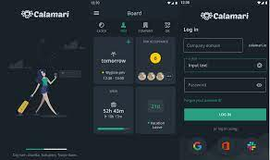
2.1. For what activities are used the actual softwares in the company?
Hostakis uses calamari.io to track employee's vacation, attendance and absence.
Calamari is a cloud-based human resources solution that offers two modules: leave management and clock in/out services.
Key features- attendance, employees, HR, Calendar, timesheet management, GPS, clock-in/out, vacation/leave tracking, remainders, overtime calculation, accounting integration, etc…
Alternatives: Toggl, CakeHR, OrangeHRM(free), Paylocity(free)...
https://youtu.be/LKPE5Z3HVYI
Notes:
Slack integration

Slide 10
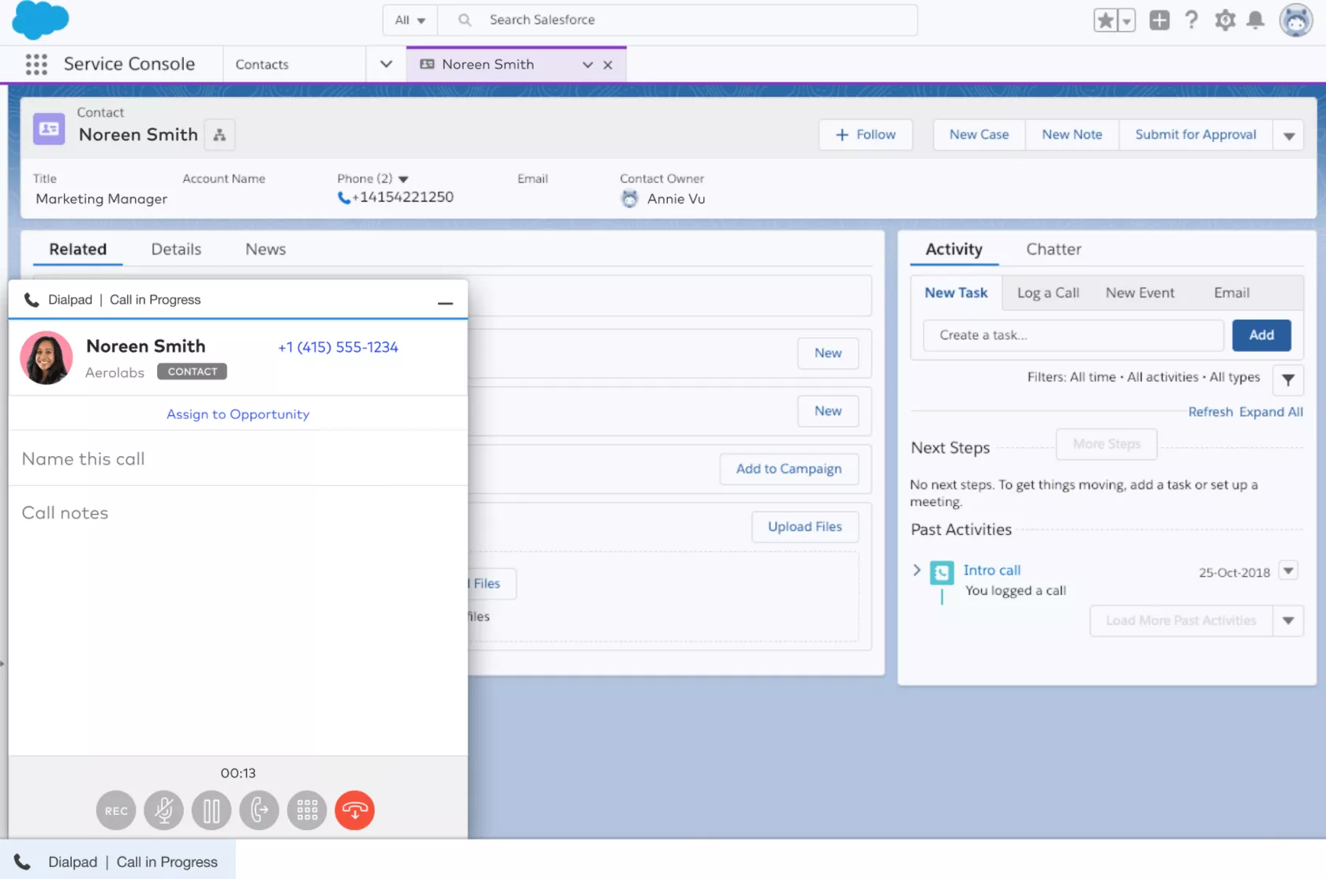
Hostakis uses 3cx.com to cut telco costs, boost employee productivity, and enhance the customer experience with webinars.
3CX is a software-based PBX solution with a cloud-hosted option, offering users web conferencing, CRM integration, live chat, instant messaging, and native mobile apps.
Key features-call logging, call popups, call queuing, call recording, click-to call, Instant messaging, compatible with Android and iOs apps, Microsoft Outlook Integration, remote assistance, Screen sharing, Voicemail forward to inbox, Web video conferencing
Alternatives: Dialpad, RingCentral, Nextiva…

Slide 11
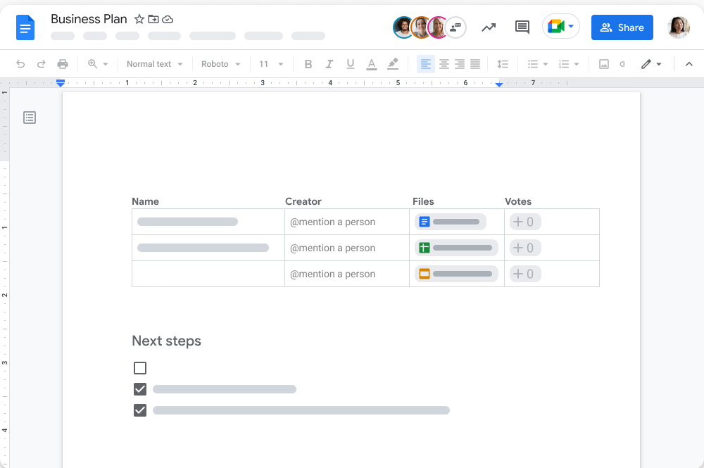
Hostakis uses Google Docs to create and edit documents and work in a team, and especially for its easy accessibility from anywhere.
Google Docs is a free online word processor software.
Key features: activity tracking, collaboration tools, document generation, file sharing, real time updates, secure data storage, chat/messaging, data import/export, search/filter, team chat, project management, etc…
Alternatives: Office 365, HighQ, Huddle, Zoho Docs, ONLYOFFICE docs, etc…

Slide 12
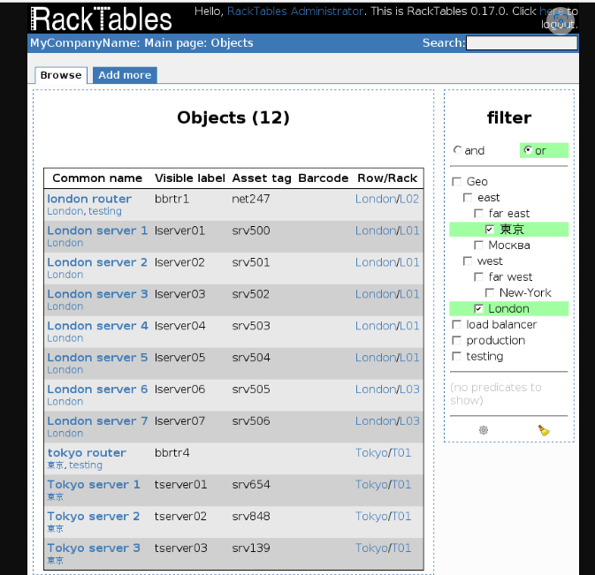
Hostakis uses RackTables instead of rack space worksheets, to manage racks in different locations, the objects mounted in racks, for tracking the virtual infrastructure and for the inventory in data centers
RackTables is is a free robust solution for datacenter and server room asset management. It helps document hardware assets, network addresses, space in racks, networks configuration, etc..
Key features: list all your devices, list all racks, mount the devices into racks, maintain physical parts of the devices and links between them, manage IP addresses, assign them to the devices and group them into networks, document your NAT rules, full support of Unicode for user’s data, etc…
Alternatives: NetBox, GLPI, Ralph, i-doit, CMDBuild

Slide 13
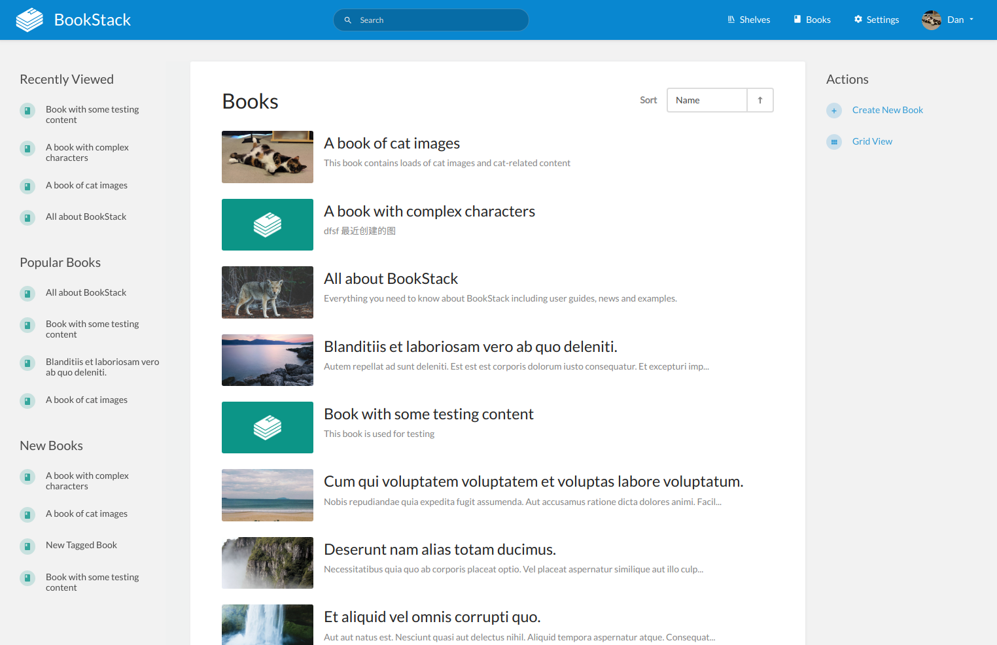
Hostakis uses BookStack to simplify the process of organizing and managing the work by breaking it down into 3 main groups: books, chapters and pages that gives an organized overview of all the documentation.
BookStack is a free open source wiki
software, self-hosted, easy-to-use, for organizing and storing information
Key features: API, Commenting/Notes, Cataloging/ Categorization, Drag&Drop, Single Sign on, Full Text Search, SSL security, Categorization/Grouping, Active directory integration, etc…
Alternatives: TiddlyWiki, DokuWiki, Wiki.js, Confluence

Slide 14
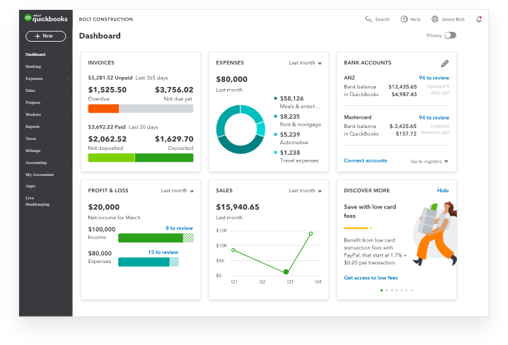
Hostakis uses QuickBooks software to track and organize the financial information within the company.
QuickBooks is a complete accounting software that allows you to manage your business from anywhere, anytime. It allows you to organize books, manage expenses, send invoices, track inventory, and even run payroll.
Key features- automated payment reminders, receipt management, track invoice history, alternative vendor reports, landed costs, inventory management, VAT management, invoicing, tracking sales and customers, etc..
Alternatives: Xero, Sage, Zoho Books, Wave Accounting(free), FreshBooks(for self-employed).
https://youtu.be/wlW5P_1FZW8

Slide 15
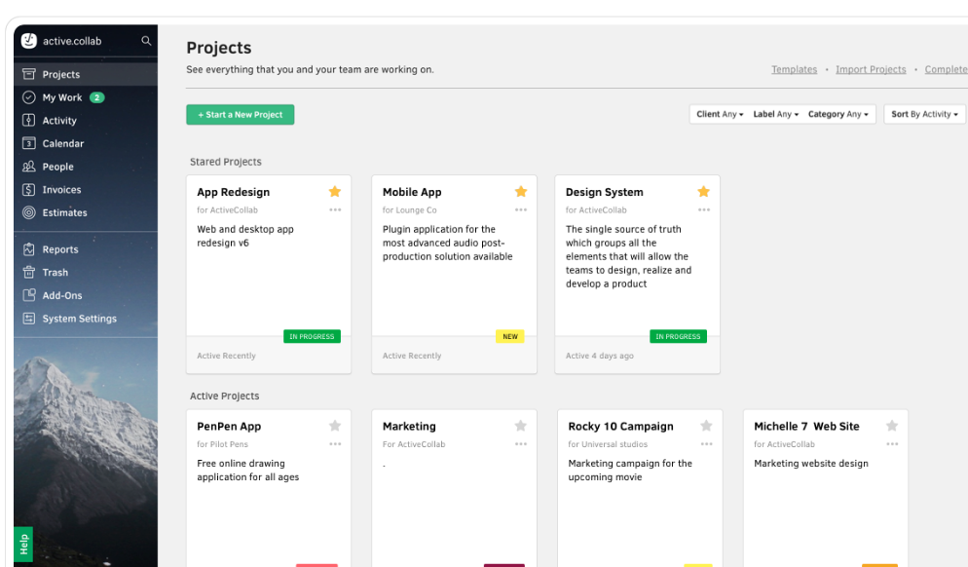
Hostakis`s project manager uses Activecollab.com to assign tasks and set deadlines.
Activecollab.com is project management software that gives complete control over the work- all tasks, communication, team members and files.
Key features- task management, collaborative writing, project management, Quickbooks & Xero integration, desktop & mobile app, budget vs cost tracking, invoicing, file management, online payments, unlimited tasks, etc..
Alternatives: Asana, ClickUp, Monday.com, Teamwork, SmartSheet, Redmine(free), Taiga.io(free)...
https://youtu.be/qQ6EtrgvwQQ

Slide 16
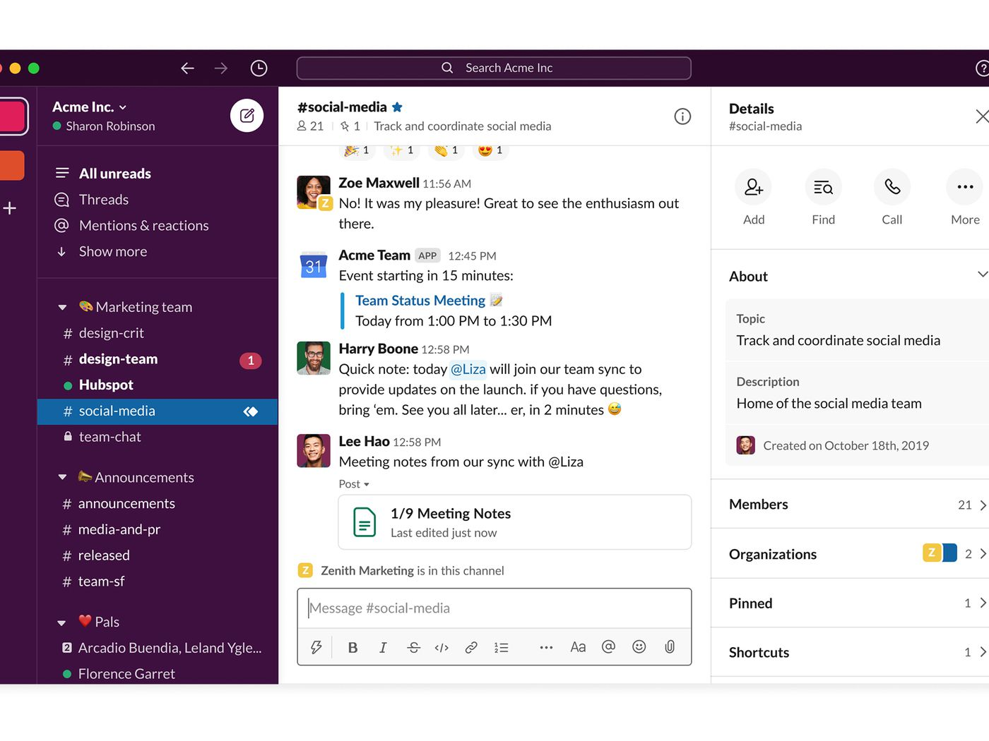
Hostakis uses slack.com software for internal teams communication and collaboration
slack.com is a cloud based project collaboration and team interaction tool to facilitate communication across organizations. Teams in Slack work together in channels that can be organized by project, department, office location, or anything else.
Key features- team chat, schedule messages, live chat, file sharing, video support, team chat, real time notifications, onboarding, real-time updates, screen sharing, issue management, API, access controls/permissions, call recording, audio calls, video conferencing, etc….
Alternatives: Rocket Chat, Hangouts Chat, Microsoft Teams(free) Facebook workplace groups(free) Chanty(free), Bitrix24(free), Fleep(free)

Slide 17
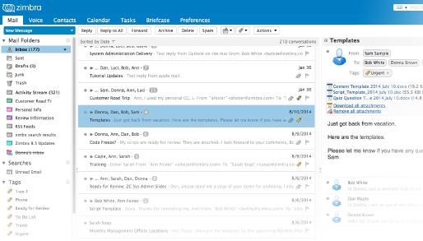
Hostakis uses zimbra.com for emailing and collaboration
zimbra.com is an open source cloud based collaborative software that includes an email server and a web client.
Key features- email, contact, calendar, communication, content management, real time editing, live chat, access controls/ permissions, mobile access, file sharing, screen sharing, video conferencing , 3rd party integrations, etc..
Alternatives: Office 365(incl.SharePoint Online), Google Workspace, MailEnable, Zoho Mail, Microsoft Outlook, etc…

Slide 18
3. How the company has chosen the information systems?
The company has chosen its BIS by doing some steps in the research:
Step 1. The company has evaluated its business to find the most important BIS for its needs.
Step 2. After that has chosen standard systems.
Step 3. Made sure to not overpay for mass features of the business system that the company does not use(evaluation of how much storage and users are needed)
Step 4. The company has chosen the all-inclusive price package in case the business grows and it is necessary to add additional modules that are already included in the package.
Step 5. Investigated the possibilities of maintenance and support(what type of support is included in the price).
Notes:
Габи
The company has chosen the most highly priced option with all features…

Slide 19


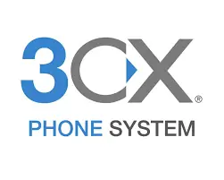

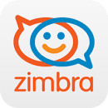


4. What kind of BIS the company has chosen?
Collaboration BIS
Communication - Slack, Zimbra, 3CX, Skype for Business, Live chat, HostBill
Content Management - Google Docs, BookStack
Workflow Control - ActiveCollab
Managerial BIS
For MIS(Management inform.system), EIS(Executive inform. system) and DSS(Decision support system) the company uses HostBill.
Notes:
Георги

Slide 20

What is best about Hostbill?
Hostakis company uses CRM-hosting software hostbillapp.com to manage billing, clients, support platforms.
Automated hosting and billing
Easy Client and Domain Management
Cloud, Saas, Web-Based Deployment
Automated Provisioning and Integration
Hourly Billing and supports multi-currency
Recurring/Subscription Billing & Tax Calculations
Easy Customer & Inventory Management
Easy Payment Handling & Payment Gateway Integration
Taxation, Contract, Order, Invoice Management
Product configurator and Ecommerce Integration
Multiple Collaboration Tools and Self Service Portal.
Notes:
И тука Георги

Slide 21
What specific products the company has chosen?
Hostakis is using the main hostbill features:
Hosting Automation
Client Management
Help Desk System
Automated Billing
Domain Management
Domain Automation
Affiliate System
Notes:
Георги щял да говори тука

Slide 22
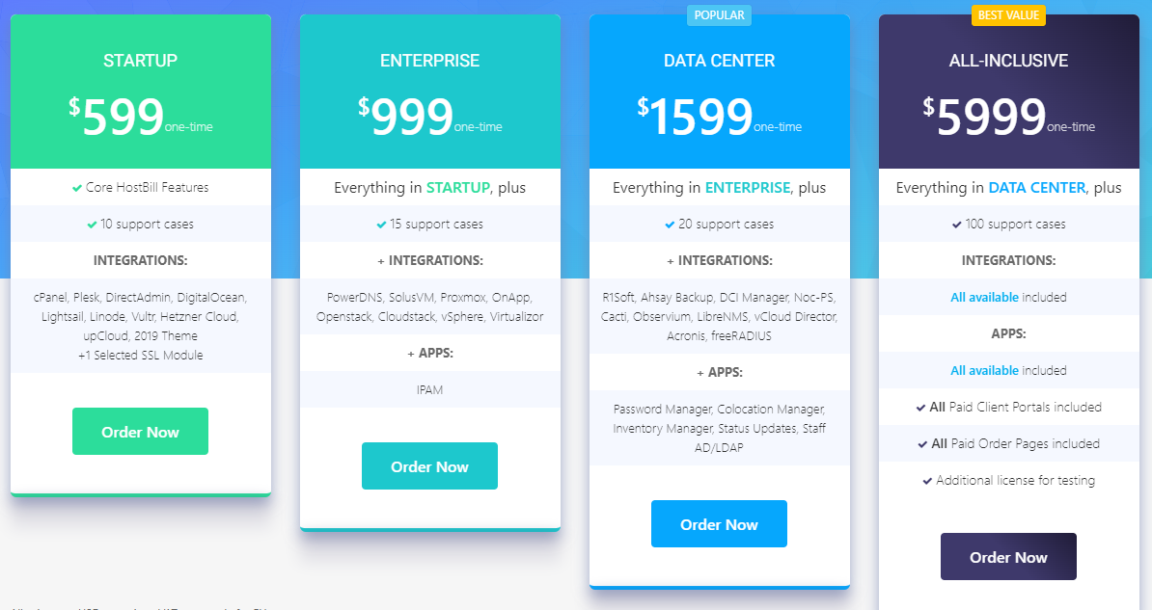
Hostbill Plans & Pricing
Hostakis company
currently has the standard, ALL- INCLUSIVE package. The company pays annual fees for support and updates.
Notes:
Georgi

Slide 23
5. What steps have been taken for the introduction of the software?
For the introduction of HostBill in the company:
The CEO has informed everyone in the company in advance that research is ongoing for choosing a new CRM software and explained its benefits and the impact on the business. He presented to the stakeholders the reasons for adopting HostBill and asked them for their requirements.
The Project Manager held training events where discussions were encouraged and answered questions to help people get familiar with the new software.
The Project Manager was monitoring the team for the test run of the new software during the trial period and was available for any questions.
They got feedback from the staff about the software, and suggestions for new features or uses.
Implementing new software isn`t easy, engaging the employees from the beginning helps to build positive habits and ensures that the new software becomes an integral part of the workflow. By planning, opening communication lines, and providing plenty of training and resources, the transition will be a success!
Notes:
Gabi

Slide 24

Does the company needs the integration of an ERP system?
Hostakis runs separate software each for accounting, inventory, CRM, HR, PM.
It makes sense for the company to graduate to an ERP to bring these together.
But Hostakis is a small company and moving to an ERP system will require a great deal of time and resources, very complex to maintain, and will be very expensive.
Some other reasons to implement an ERP system are: using too many manual processes, struggling to meet customer demand, having difficulty to access BI and create reports, for all this, Hostakis has the software solution Hostbill.
Alternatives: Open Source ERP
Notes:
Gabi

Slide 25

AI implementation
Hostakis can implement AI for improving customer service.
To save on employee costs while maximizing availability to customers, Hostakis can use chatbots. These AI-powered software or plug-ins can exist on a business’s website or app 24/7, allowing unlimited opportunity for customer engagement. The more chatbots are used (and given feedback by customers), the better and more efficiently they’ll perform. Chatbots are capable of performing many tasks, from troubleshooting issues to starting conversations with potential customers. If a customer’s needs are too complex, however, the chatbot can recommend and arrange human interaction.
Notes:
Gabi

Slide 26
Conclusions
Hostakis has invested a lot of financial resources into acquiring and utilizing business information systems to improve performance and productivity. The implementation of them was successful and the company has achieved to return on its investments.
In future, when the business grows more, Hostakis may implement an ERP system for its needs, and more AI like to predict customer behaviour.
Notes:
Eli

Slide 27
Thank You !

